Slide 1
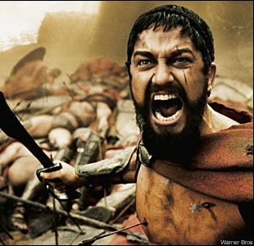
THIS IS SPARTA
SPARTAN SOCIETY TO THE BATTLE
OF LEUCTRA 371 BC

Slide 3
Meet the spartans
The Spartans were unique in the ancient world.
For reasons partly unknown, they developed a society almost completely geared for war.
Very few primary sources from Sparta have survived. Our view of Spartan society is formed from ancient writers not totally devoid of bias.
Ancient writers were divided in their views on Sparta.
Much of what is known is disputed and remains the subject of debate.

Slide 4
Myths
It was a society based on equals.
All things were owned and shared in common, so that society was not divided into rich and poor.
They were uncultured and illiterate.
All the changes that took place in their society were due to a lawgiver called Lycurgus.
They were an unbeatable fighting force.
Theirs was a perfect, well-ordered society, free from civil strife.
Spartan men were thought to be homosexual because they spent a significant amount of time in the barracks with other men.

Slide 5
ORIGINS
The origins of the Spartan people are lost in ancient myths and conjecture.
The Mycenaean civilisation existed around surrounding areas of the Peloponnese, however their civilisation is said to have collapsed c.1200-1100 BC.
Writings from Pausanias, an ancient Greek writer (2nd century AD), and the better known Homer (8th century BC), tell of Spartans that pre-date 1000 BC. Homer in particular mentions Spartans taking part in the Trojan War, c.1194-1184 BC.
Historic Sparta, however, is believed to have emerged around the 9th century BC.

Slide 6
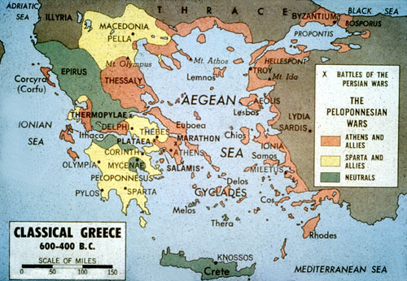
Geographical setting

Slide 7
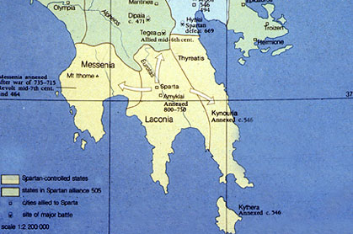
Map of Sparta

Slide 8
Geographical setting
The geographical setting, natural features and resources of ancient Sparta.
Spartans were referred to in historical texts by a number of names:
Spartans – derived from the city-state of Sparta.
Laconians – from Sparta’s location on the plains of Laconia.
Lacedaemonians – Lacedaemon referred to the broader political unit of Sparta and the areas it controlled.
Peloponnesians – Sparta was situated in the large peninsula of southern Greece, known as the Peloponnese.
Dorians – the word ‘Dorian’ was often used to describe the Spartans on the basis of their cultural/political characteristics.

Slide 9
Cont…
Set on one of the most fertile plains in Greece - good for growing crops and grazing horses.
Consisted of five villages and large rural area, unlike typical Greek city-states which comprised of a single city.
Four of Sparta’s villages were situated on the Eurotas River, which provided Sparta’s water supply.
Bordered by three mountain ranges:
Taygetus mountains in the West.
Parnon mountains in the East.
Arcadian mountains in the North.

Slide 10
Cont…
These mountains formed a natural barrier for Sparta, both protecting and isolating it from the rest of Greece.
Climate was cold in winter (snow on Taygetus mountains) and hot in summer.
Rainfall was light but adequate.
Main harbour was Gytheion.

Slide 11
Cont…
Invading Dorian tribes took control of the land and made the native peasants into helots – state-owned serfs who had to work the land.
Around 750 BC, they expanded and took the lands of the neighbouring Messenia. Messenians were also made into helots.
Laconia and Messenia were then joined and known as Lacedaemon.

Slide 12
Cont…
Natural resources of Laconia and Messenia included:
Iron and lead.
Crops – barley and wheat
Fruit orchards – figs, olives, grapes (for wine)
Plains to graze sheep and goats, which provided milk, cheese, skins, wool, hair and fat.
Pigs and hens.
Animals hunted for food and sport.
Bees to provide honey and wax.
Timber and stone from mountains.
Shellfish and fish from Gytheion (shellfish also provided dye for the textile industry).

